Slide 1

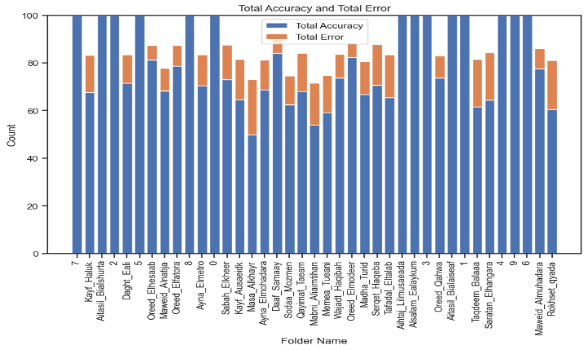
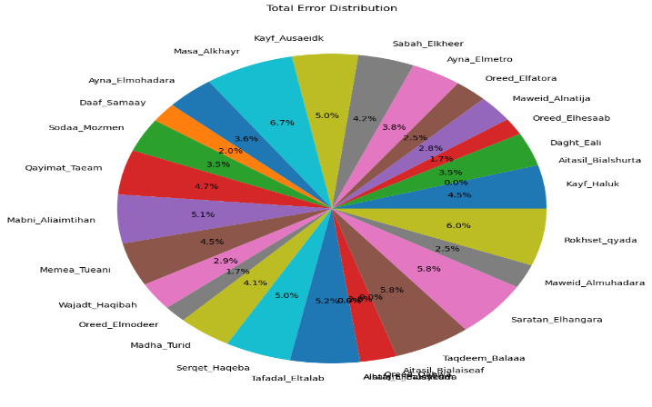
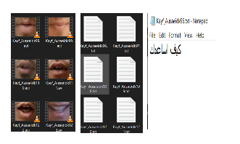
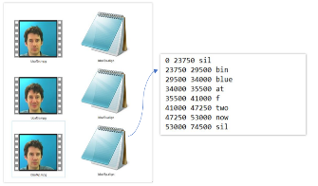
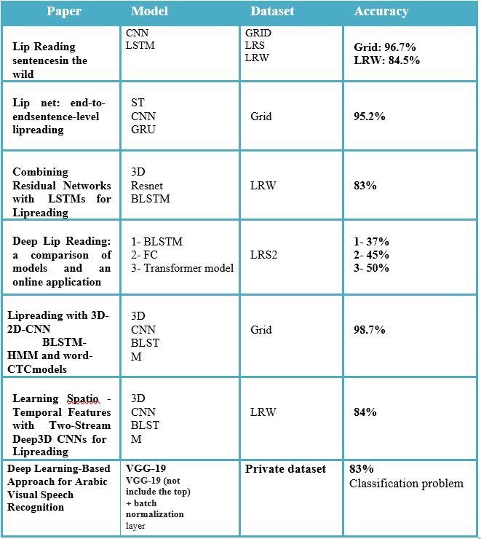
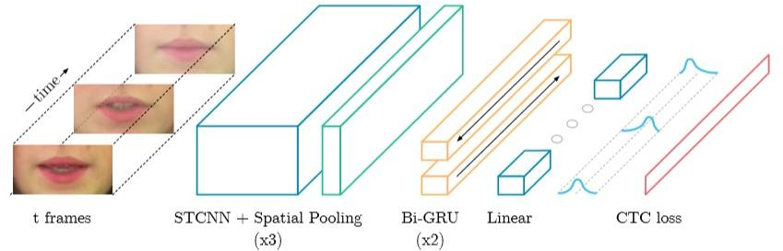
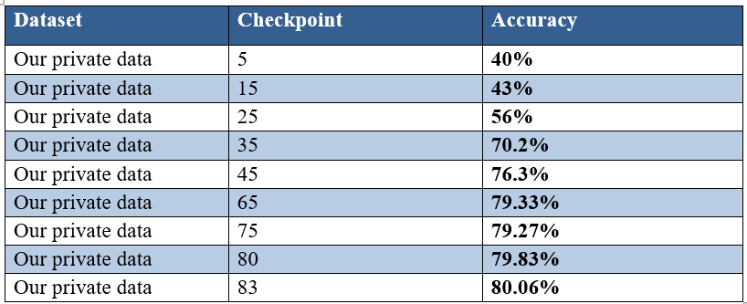
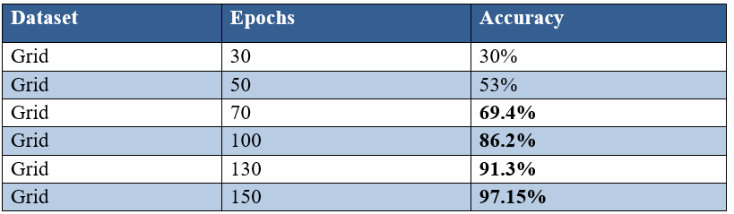
I Can Hear You Arabic and English Lip-reading
INTRODUCTION
Lipreading, or speechreading, is the visual interpretation of lip, face, and tongue movements to understand speech without sound. It is crucial for human communication and speech comprehension. Visual speech recognition, known as lipreading, is gaining attention as a complementary field to audio-based speech recognition. It aids dictation in noisy environments and allows for silent dictation in offices and public spaces. Additionally, it has applications in improving hearing aids and enhancing biometric authentication.
People with hearing problems as deaf people face difficulties in communicating with other people, some of whom may not know sign language. Lip reading is one communication skill that can help them communicate better and understand what is being said. movements and translating them into text.
Assisting individuals with hearing difficulties in understanding speech is crucial. Since human lipreading performance is often limited, unlike machine lipreaders that offer significant practical potential, converting videos of people speaking into text can greatly enhance communication for deaf individuals. This technology enables them to easily interact and engage with society.
The accuracy for our project for Arabic is 80% and English is 97%
Arabic accuracy graph
Error distribution over the results in Arabic dataset
Mamoud.S AbldeRahman
Mahmoud.S Sayed
Eman.I yusuf
Nourra.A Hafez
Aalaa.A Mohamed
Dr. Mohamed Mabrouk
TA. Hazem Yousef
Computer Science Department
Faculty Of Computers And Information Sciences
Ain Shams University
Datasets
In our project we used two different datasets, the first one was our Arabic dataset, and the second one was GRID.
ABSTRACT
PIPLINE AND MODEL
DISCUSSION
As not many people know sign language or can interpret lip movements, deaf people suffer while trying to communicate with other people. This project contributes to ease the communication between them by developing an application that tracks the lip movements of the talking person in a video trying to predict what is being said and display it as text.
This web application can determine the start and end frame of each spoken word by knowing the start and end time of it in the video. Then it extracts the mouth from this range of frames because it is the region of interest and tries to map these frames t o this spoken word.
In this project has two different models
• For Arabic this model takes 3D input data, applies convolutional and pooling operations to extract spatial features, processes the temporal information using bidirectional GRU layers, and produces a probability distribution over the classes using a dense layer followed by SoftMax activation, accuracy 80%.
• For English, this model takes 3D input data, applies convolutional and pooling operations to extract spatial features, processes the temporal information using bidirectional LSTM layers, and produces a probability distribution over the classes using a dense layer followed by SoftMax activation, accuracy 97%.
Our graduation project involved working with the Arabic language, which presented us with significant risks and challenges. Unlike English, there was a scarcity of existing outputs and resources for Arabic language processing. However, despite the difficulties, we found the experience to be fulfilling and enjoyable. Achieving an accuracy of 80% in Arabic and 97% in English was a remarkable achievement for us. We believe that this progress indicates a positive trajectory for future advancements in Arabic language processing. We maintain an optimistic outlook for Arabic language research and development, eagerly anticipating further breakthroughs that will benefit the Arab community.
Take an input video as frames
Face detection
Mouth landmarks detection and mouth clipping
Convert the clipped frames to video
Preprocess the video
grayscale
Normalization
Feed video to model
Extract the decoder from CTC loss
Comparison results
Convert the decoder to text
Arabic
English
Model Architecture
RESULTS
CONCLUSIONS
Arabic results
Working with the Arabic language in our graduation project presented us with a significant risk and challenge. Unlike English, there was a lack of previous outputs and resources available for Arabic language processing. However, despite the difficulties, we found the experience to be enjoyable and rewarding. Achieving an accuracy of 80% in Arabic and 97% in English was a remarkable accomplishment for us. We hope that this progress signifies a positive trend for future advancements in Arabic language processing. We remain optimistic about the prospects for Arabic language research and development in the coming years, and we look forward to witnessing further advancements that will benefit the Arab community.
CONTACT
Mahmoud.S AbdelRahaman
FCIS Ain Shams University
Qalupia , Egypt
Email: mahmoud.salama.gado@gmail.com
Phone: +2 01061835782
English results
REFERENCES
Y. M. Assael, B. Shillingford, S. Whiteson, and N. de Freitas, “LipNet: End-to-End Sentence-level Lipreading,” pp. 1–13, 2016.
” The Oxford-BBC Lip Reading Sentences 2 (LRS2) Dataset” http://www.robots.ox.ac.uk/~vgg/data/lip_reading/lrs2.html#:~:text=Overview,divided%20according%20 to%20broadcast%20date. (accessed Feb. 20, 2020).

